Slide 1
Agenda –April 12, 2018
• Talent@Iowa updates – Keith and Angie
- Jobs New Website Design concept – Keith and Angie
- Communication Talking Points – Lin
- Summary of change management conversations -Teresa
• Talent Acquisition Strategy preliminary discussion – Attract, Engage, Recruit- Joni and Talent Acquisition Team (Jan, Wanda, Keith)

Slide 2
UI Project Team Updates

Slide 3
Project Updates
Decisions to Date (through April 2nd)
Strategy Committees (Attract, Engage, Recruit) kicked off on 3/26
Job Aggregator final contract anticipated by 4/6
Marketing concepts completed
Upcoming
Recruiter Identification interviews in progress
Continued design sessions and initial configurations

Slide 4


Slide 5
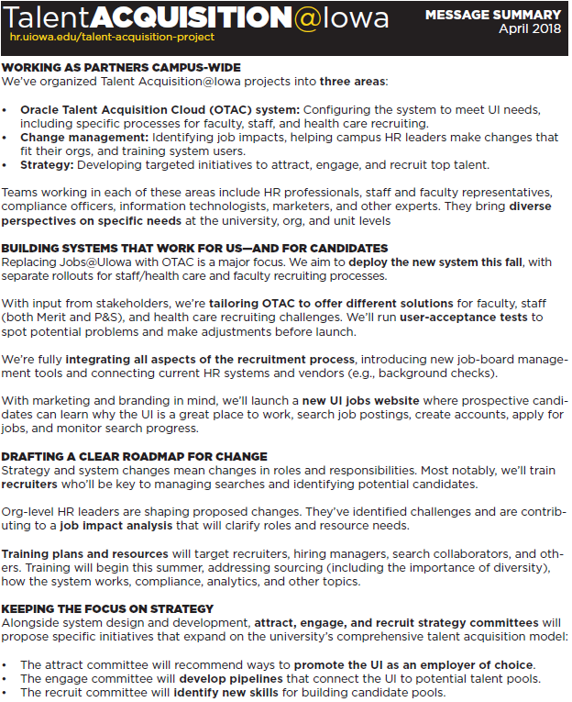

Slide 6
Talent Acquisition
Change Readiness Assessment:
Results and Recommendations
(Short Brief) by Teresa Kulper and Blair Wagner
March 27, 2018

Slide 7
Table of Contents
Topic | Slide #
Change Readiness Assessment: Goals, Objectives, Assessment Approach | 3
Results & Next Steps | 7
2

Slide 8
CHANGE READINESS ASSESSMENT:
Goals, Objectives, Assessment Approach

Slide 9
Goals & Objectives: Insights
Understand Senior HR Leadership, Governance Council, and Core Project Team perspectives on the project
Measure readiness and ability to accept change
Identify risks or barriers to successful adoption
Gather information on preferred communication and training channels

Slide 10
Goals & Objectives: Outcomes
Determine mitigating strategies for identified risks
Leverage insights to strengthen training and communication plans
Identify preferred recruiter model (for each organization) and potential recruiters

Slide 11
Three-Pronged Assessment Approach
Governance Council Discussion
Change Readiness
Assessment
Core Project Team Interviews
Senior HR Leader Interviews

Slide 12
Results & Next Steps

Slide 13
Senior HR Leader Interviews:
Lessons Learned/Recommendations Recap
Clarity is key: role definitions, timelines, expectations, data.
1
Communication and training: frequent, multi-level communication with scripts, time to
prepare, and opportunity for input/feedback. In-depth training heavy on visuals.
2
Support before, during, and after the transition.
3
4
Positive about the new system and ready (generally) to transition toward a shared/
centralized model. Eager for assistance from project team during the transition.

Slide 14
Governance Council Discussion:
Lessons Learned/Recommendations Recap
1
The Governance Council is ready to be a 2-way communication conduit for the project.
2
Transparency is key to engagement.
3
Short, frequent communications (early and often) should be tailored to different
audiences and focused on stories and wiifm messages.
4
A variety of training should be offered at different levels and provided in small snippets
(available online and offline).

Slide 15
Core Project Team Interviews:
Lessons Learned/Recommendations Recap
Manage messages carefully: different audiences, timing, methods, language, etc.
1
Prepare Senior HR Leaders and recruiters early
2
Provide a variety of training methods for different audiences. Ongoing support is key!
3
4
Bring faculty along throughout the process.

Slide 16
Change Readiness Summary
The HR community is eager for the new system and overall is ready to take a step toward a shared/centralized model (e.g., exploring centralization of certain job functions similar to the IT model)
The project team needs to be transparent with the stakeholders throughout the project – during ups and downs of the project.
Senior HR Leaders want to be prepared early and want help preparing for the new recruiter model (role definitions, timelines, expectations, data)
A variety of training should be offered at different levels and provided in small snippets (available online and offline) – heavy on visuals
Organizations are expecting a lot of support (before, during, and after the transition).
Senior HR Leaders want the opportunity to provide input/feedback throughout the project.

Slide 17
Change Readiness Summary: Communications
Detail communication plan for all stakeholders
Short, frequent communications
(early and often)
Communication scripts for Senior HR Leaders
Success stories
WIIFM messages
Varied methods,
multiple audiences

Slide 18
Next Steps
Create a robust communication plan.
Finalize a recruiter model for each organization.
Provide organizations with support to successfully select and prepare recruiters.
Reach out to organizations who have been identified as needing support with the transition.

Slide 19
Talent Acquisition @Iowa Attract Committee Charter
Charge
Research, propose, and implement strategies and tools to attract faculty and staff and market the UI as employer of choice
Deliverables
Initiation: Research marketing and communication strategies and best practices in attracting faculty and staff
Planning: Develop recommendations regarding marketing and communication strategies and best practices in attracting faculty and staff through community engagement and employer branding
Implementation: Utilize the employer brand, develop community-focused events, and initiate marketing campaigns.
Provide monthly updates to TalentAcquisition@Iowa Governing Council regarding progress of initiative.
Evaluation: Evaluate effectiveness of marketing and communication strategies.
Reference
Talent at Iowa Report and Recommendations
Talent Acquisition Talent@Iowa Governance Council Presentation given on September 14, 2017
TalentAcquisition@Iowa Infographic
Committee Membership
The Attract Committee will be chaired by Jan Waterhouse and is sponsored by the Human Resources Department. Committee members include: Amy Kirkey, Ruthina Malone, Amanda Petersen, Lisa Carmack, Alaina Hanson
HR Administrative Liaison: Teresa Kulper
Timeline: Ongoing to support the functional deliverables of the Taleo implementation as well as future talent acquisition initiatives post implementation.
Develop comprehensive talent strategies: Meet the needs of a world-class research university and leading academic medical center with initiatives that attract top faculty and staff (e.g., central support for employer branding and advertising), enhance internal mobility (e.g., leadership development), and create new pipelines (e.g., encouraging students to explore UI jobs). (Talent acquisition, appendix 6)

Slide 20
Talent Acquisition @Iowa Engage Committee Charter
Charge
Research, propose, and implement strategies and tools to engage and cultivate talent pipelines for the University of Iowa.
Deliverables
Initiation: Research pipelines, posting, career enhancement, and incentive strategies and best practices in engaging diverse potential faculty and staff.
Planning: Develop recommendations regarding engagement strategies and best practices in cultivating talent pipelines to attract attention from
potential candidates.
Implementation: Leverage and expand pipelines, identify posting strategies, enhance diversity recruiting/retention, and develop incentive
programs.
Provide monthly updates to TalentAcquisition@Iowa Governing Council regarding progress of initiative.
Evaluation: Evaluate the effectiveness of engagement strategies.
Reference
Talent at Iowa Report and Recommendations
Talent Acquisition Talent@Iowa Governance Council Presentation given on September 14, 2017
TalentAcquisition@Iowa Infographic
Committee Membership
The Engage Committee will be co-chaired by Wanda Malden and Shamika Patterson and is sponsored by the Human Resources Department. Committee members include: Emily Kleinmeyer, Becky Rafferty, Sharon Beck, Wendy Loney, and Adam Potter Student participants: Don Braithwaite, Hannah Shrader
HR Administrative Liaison: Cheryl Reardon
Timeline: Ongoing to support the functional deliverables of the Taleo implementation as well as future talent acquisition initiatives post implementation.
Mapping of Talent@Iowa Task Force Recommendation
Develop comprehensive talent strategies: Meet the needs of a world-class research university and leading academic medical center with initiatives that attract top faculty and staff (e.g., central support for employer branding and advertising), enhance internal mobility (e.g., leadership development), and create new pipelines (e.g., encouraging students to explore UI jobs). (Talent acquisition, appendix 6)

Slide 21
Talent Acquisition @Iowa Recruit Committee Charter
Charge
Research, propose, and implement strategies and tools to
develop and train staff on modernized recruitment processes and steps for hiring at the University of Iowa.
Deliverables
Initiation: Create training and skill development opportunities identified through technical implementation of modernized recruitment processes and steps.
Planning: Develop recommendations regarding training and skill development strategies and best practices in recruiting and hiring processes.
Implementation: Train and develop skills of staff related to application, interview management, screening, and selection practices to hire top candidates into UI
positions.
Provide monthly updates to TalentAcquisition@Iowa Governing Council regarding progress of initiative.
Evaluation: Evaluate effectiveness of recruitment strategies.
Reference
Talent@Iowa Report and Recommendations
Talent Acquisition Talent@Iowa Governance Council Presentation given on September 14, 2017
TalentAcquisition@Iowa Infographic
Committee Membership
The Recruit Committee will be chaired by Keith Becker and is sponsored by the Human Resources Department. Committee members include: Talinda Pettigrew, Cathy Koebrick, Maeve Jackowski, Kate Banta
HR Administrative Liaison: Joni Troester
Timeline: Ongoing to support the functional deliverables of the Taleo implementation as well as future talent acquisition initiatives post implementation.
Mapping of Talent@Iowa Task Force Recommendation
15. Develop comprehensive talent strategies: Meet the needs of a world-class research university and leading academic medical center with initiatives that attract top faculty and staff (e.g., central support for employer branding and advertising), enhance internal mobility (e.g., leadership development), and create new pipelines (e.g., encouraging students to explore UI jobs). (Talent acquisition, appendix 6)
O Implement a state-of-the-art talent management system: Plan, budget, and acquire tools that address emerging talent-management strategies, starting with talent acquisition. Address the full suite of talent management needs for varied constituencies in a time frame that respects those needs.
17. Expand diversity processes and tools: Promote best practices and recruitment resources, in part through training for search chairs, supervisors, administrators, and HR professionals. (Talent acquisition, appendix 6)

