Slide 1
2024 Working at Iowa <insert org> Results
Spring 2025

Slide 2
Working at Iowa survey
Working at Iowa is a biennial campuswide survey that measures engagement and belonging among University of Iowa faculty and staff.
Results from the Working at Iowa survey help us identify trends in success and areas for improvement. These insights lead to action plans that enhance our workplace, making Iowa a place where all employees feel valued, supported, and engaged.
<Insert org/department's areas of focus from past survey(s), action plans, and progress made>

Slide 3
Participation, Acknowledgement, & Response Rates

Slide 4
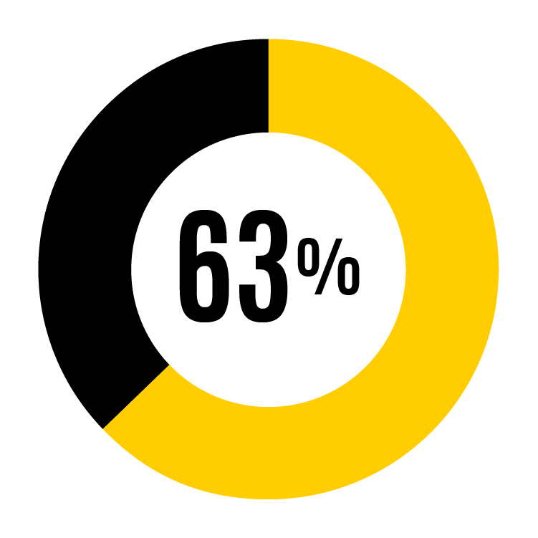
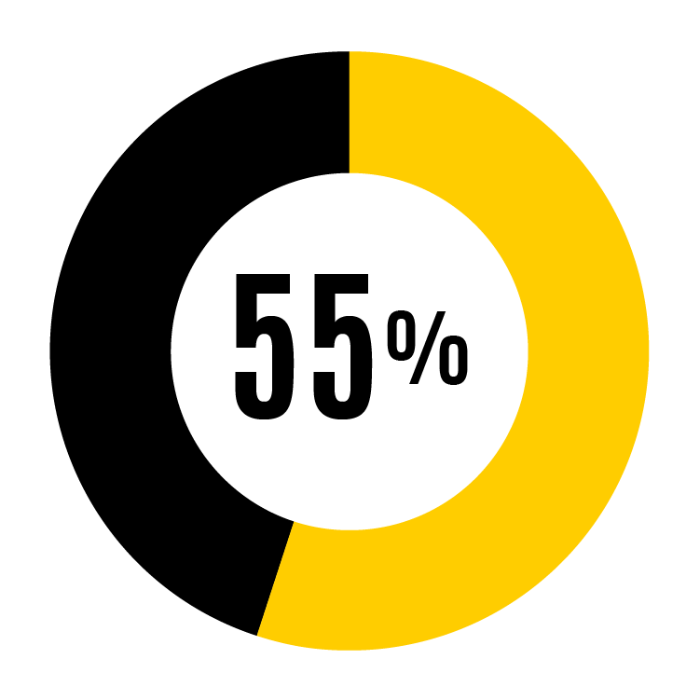
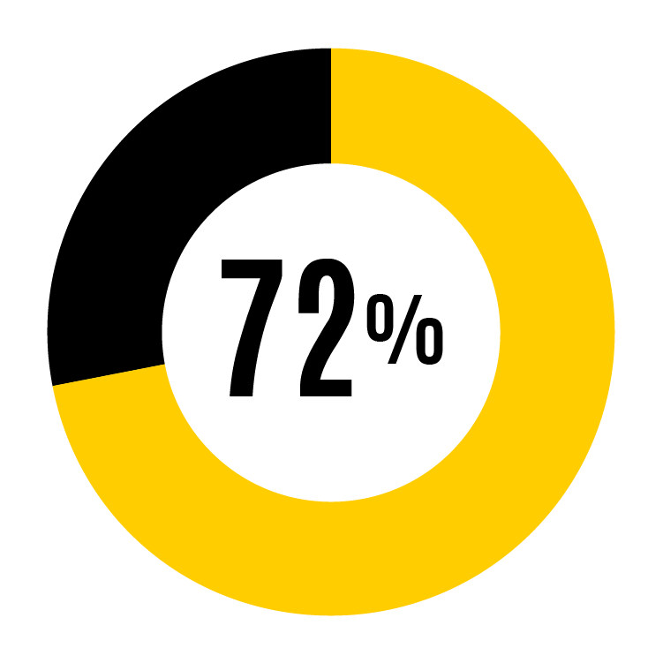
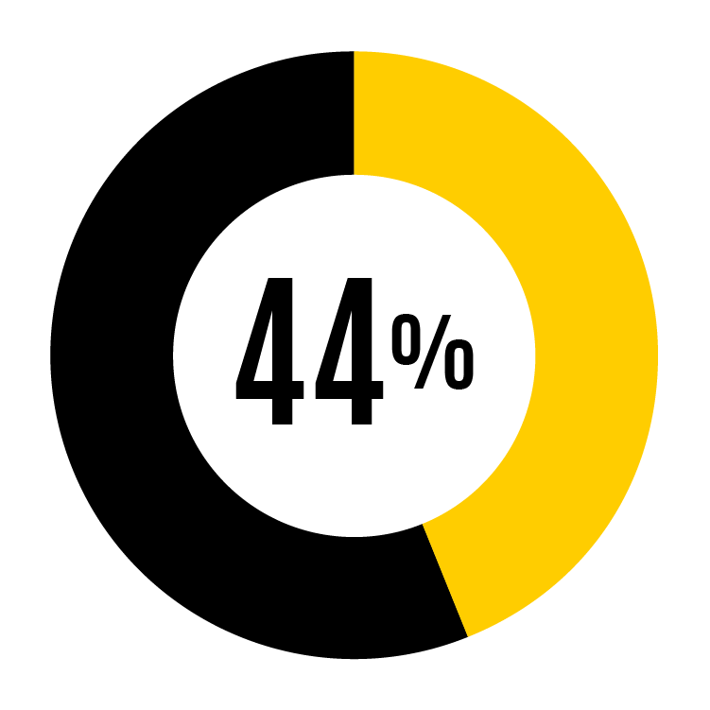
2024 response rates
Faculty and staff responses by job classification
Faculty
879 responding from 1,612 administered
P&S
2,781 responding from 3,843 administered
Faculty and staff main campus responses
4,163 responding from 6,609 administered
Faculty and staff that work 50%+
Merit
503 responding from 1,154 administered
Notes:
This is the UI response rate.
This is the academic side of campus. No students, postdocs, or health care.

Slide 5
2024 response rates <insert org specific data>
Faculty and staff responses by job classification
Faculty
879 responding from 1,612 administered
P&S
2,781 responding from 3,843 administered
Faculty and Staff main campus responses
4,163 responding from 6,609 administered
faculty and staff that work 50%+
Merit
503 responding from 1,154 administered
Notes:
Participation Acknowledgment: Thank everyone for their feedback and participation.

Slide 6
Summary of Findings

Slide 7
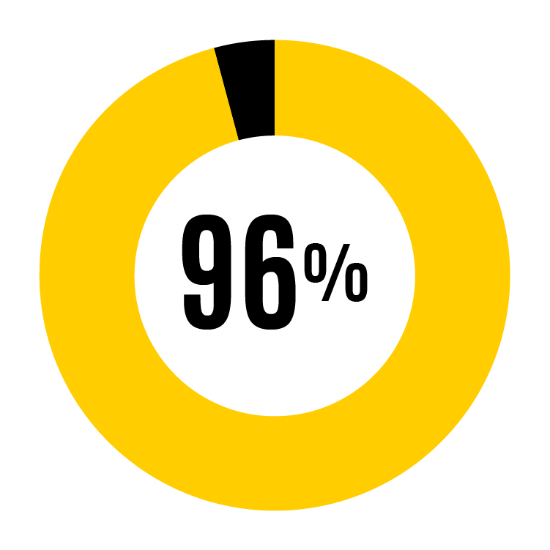
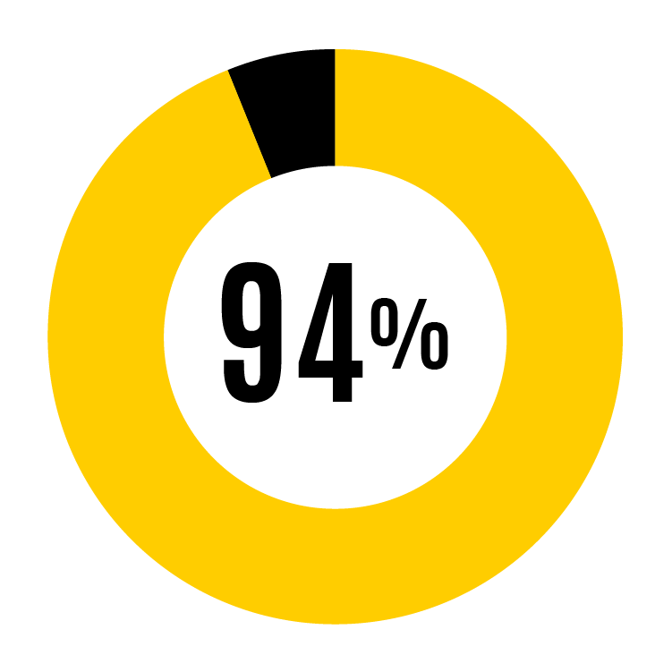
Strengths – All UI
I know my work expectations
My supervisor treats me with respect
My unit focuses on excellent service
% of respondents who agreed (slightly agree, agree, strongly agree)

Slide 8
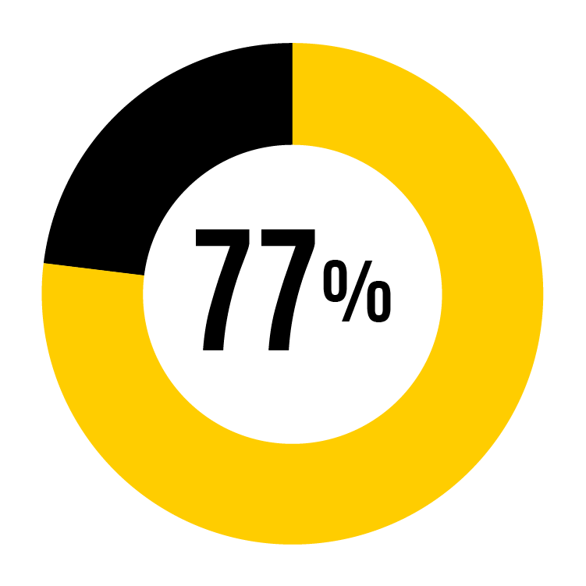
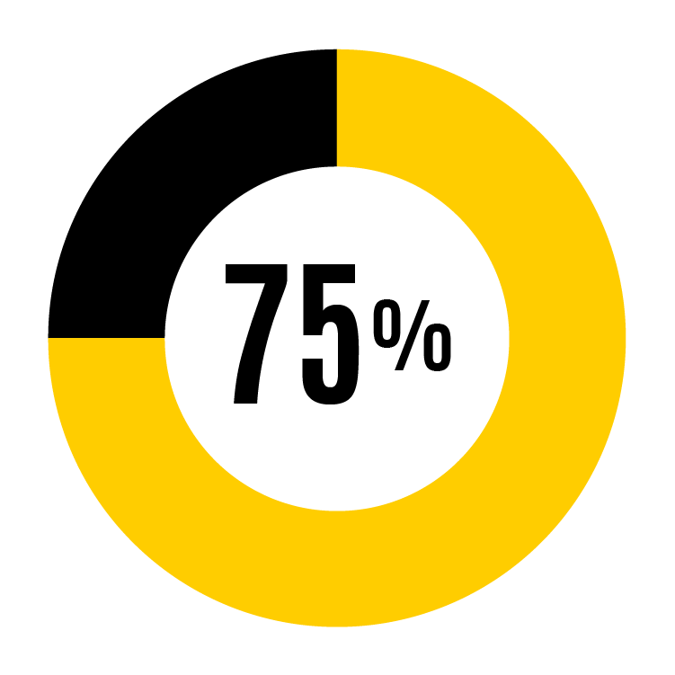
Opportunities – All UI
I feel valued as an individual at the UI
My unit distributes workloads fairly
UI recognizes accomplishments of faculty/staff
% of faculty and staff respondents who agreed (slightly agree, agree, strongly agree)

Slide 9
Strengths <insert org specific data>
Insert % from slide 10 or 11
Insert % from slide 10 or 11
Insert % from slide 10 or 11
insert org specific strength #1
insert org specific strength #2
insert org specific strength #3
% of faculty and staff respondents who agreed (slightly agree, agree, strongly agree)

Slide 10
Opportunities <insert org specific data>
Insert % from slide 10 or 11
Insert % from slide 10 or 11
Insert % from slide 10 or 11
insert org specific opportunity #1
insert org specific opportunity #2
insert org specific opportunity #3
% of faculty and staff respondents who agreed (slightly agree, agree, strongly agree)

Slide 11
Survey shifts from 2022 <insert org specific data>
New in 2024: Infographic provides snapshot of university-wide results
Questions with ≥5% shift from 2022 | Faculty | P&S | Merit | Overall
Q5: I am encouraged to allocate time to my professional development.
5 to 7% shift 8-10% shift 11%+ shift

Slide 12
Survey shifts from 2022 Icons
New in 2024: Infographic provides snapshot of university-wide results
5 to 7% shift 8-10% shift 11%+ shift

Slide 13
2024 results by theme: Goal Clarity <insert org specific data>
Goal Clarity
Related Survey Questions | 2024 | Trend*
Q1: I know my work expectations | 96% | +1
Q9: My unit goals are clear
Q10: My unit focuses on excellent service
Q19: Understand how job fits mission of UI
*Trend means the shift in percentage points compared to the 2022 survey.
** Infographic

Slide 14
2024 results by theme: Institutional Satisfaction <insert org specific data>
Institutional Satisfaction
Related Survey Questions | 2024 | Trend*
Q20: UI recognizes accomplishments | 72% | =
Q21: I can pursue career goals at UI
Q24: Would recommend UI to a friend
*Trend means the shift in percentage points compared to the 2022 survey.
** Infographic

Slide 15
2024 Results by theme: Workplace Culture <insert org specific data>
Workplace Culture
Related Survey Questions | 2024 | Trend*
Q8: I can be my authentic self at work |  | New
Q11: My unit distributes workloads fairly | 75% | +2
Q12: My unit supports work & personal life
Q13: I have a voice in unit’s direction |  | New
Q14: Conflicts are managed
Q15: Coworkers are civil and respectful
Q16: My unit provides a supportive environment to retain individuals from diverse backgrounds
Q17: I say great things about my unit
Q18: My team in my unit values me |  | New
Q22: I feel valued as an individual at UI |  | New
Q23: UI is welcoming and respectful |  | New
*Trend means the shift in percentage points compared to the 2022 survey.
** Infographic

Slide 16
2024 results by theme: Supervisor-Employee Relationship <insert org specific data>
Supervisor-Employee Relationship
Related Survey Questions | 2024 | Trend*
Q2: I receive work feedback regularly | 84% | =
Q3: My supervisor’s feedback is helpful
Q4: Supervisor acknowledges good work
Q5: My prof development is encouraged
Q6: My supervisor treats me with respect
Q7: My supervisor is open to hear concerns
*Trend means the shift in percentage points compared to the 2022 survey.
** Infographic

Slide 17
2022 Focus Areas <insert survey scores for areas of focus>
Insert % from slide 10 or 11
Insert % from slide 10 or 11
Insert % from slide 10 or 11
insert org specific data
insert org specific data
insert org specific data
% of faculty and staff respondents who agreed (slightly agree, agree, strongly agree)

Slide 18
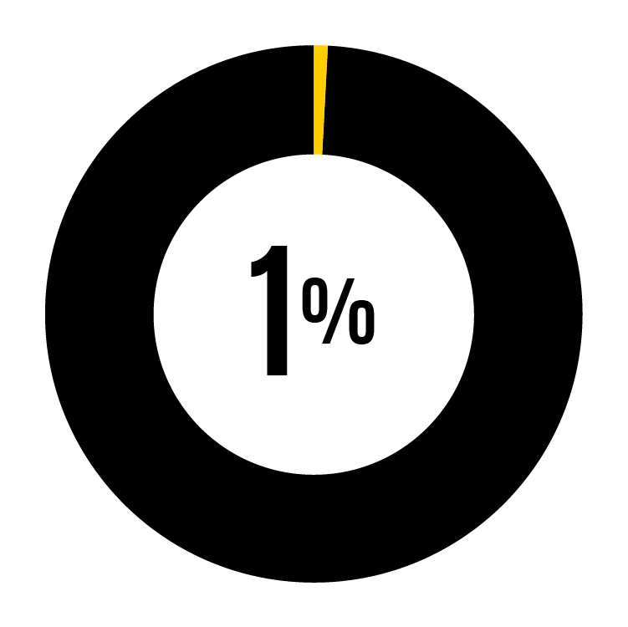
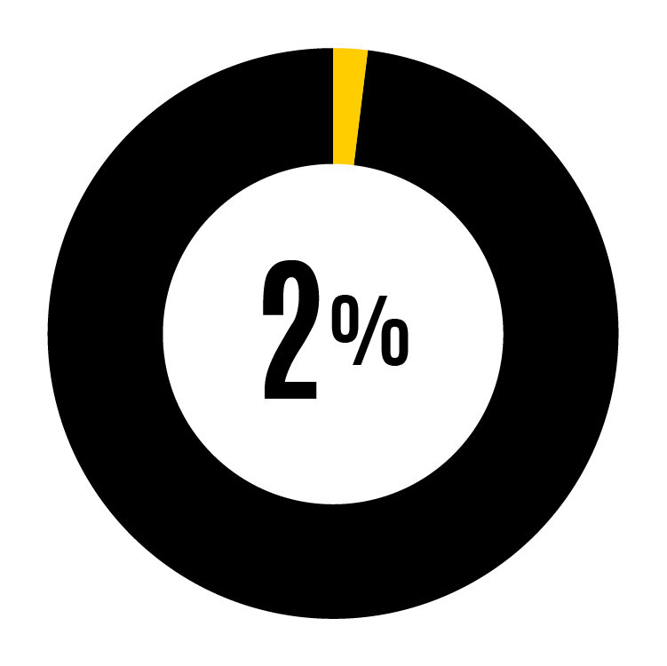
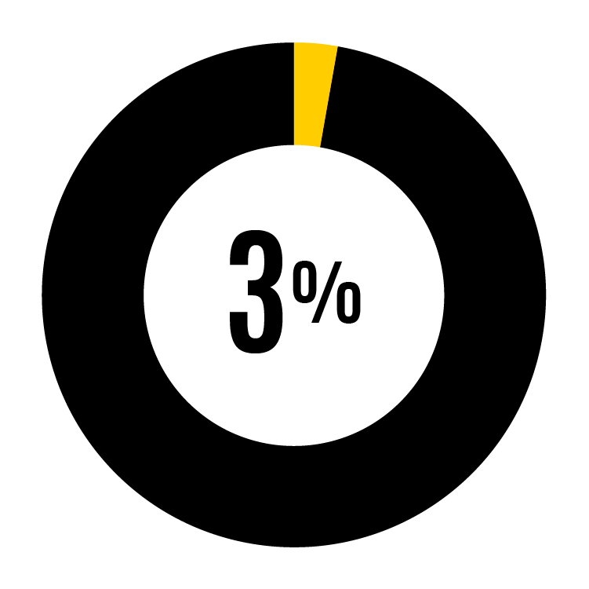
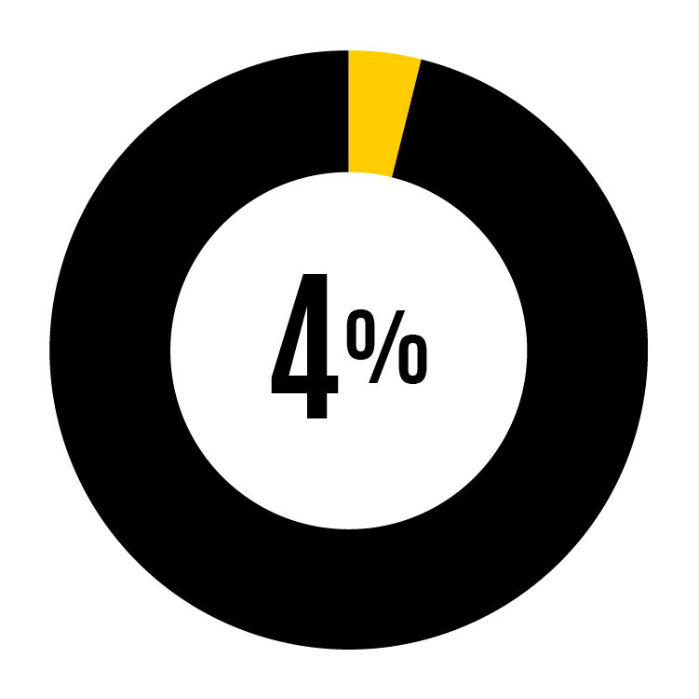
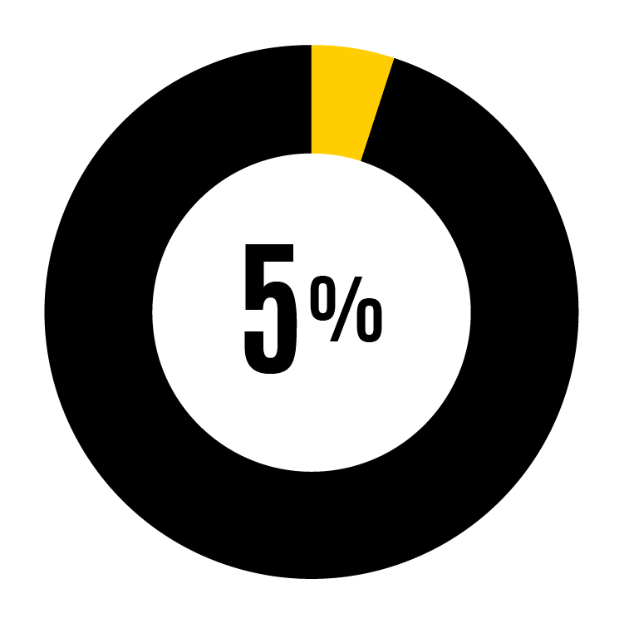
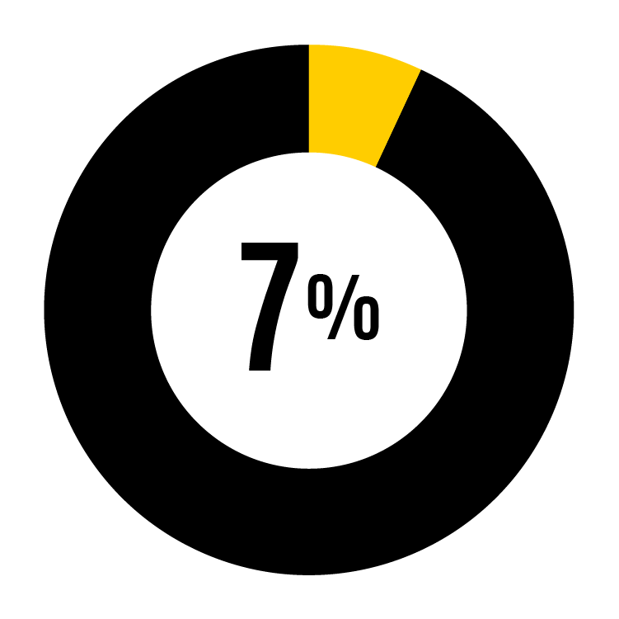
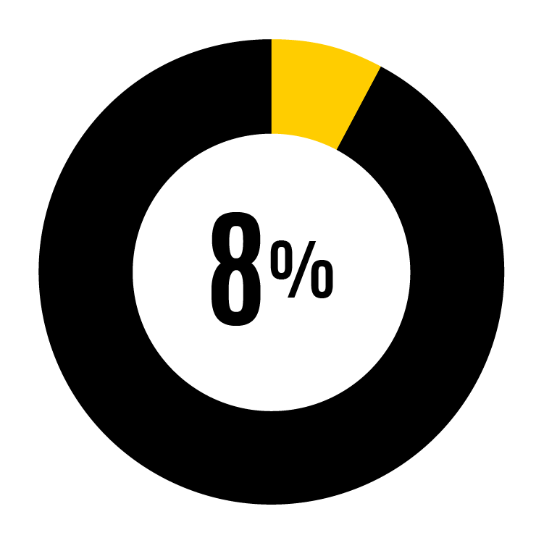
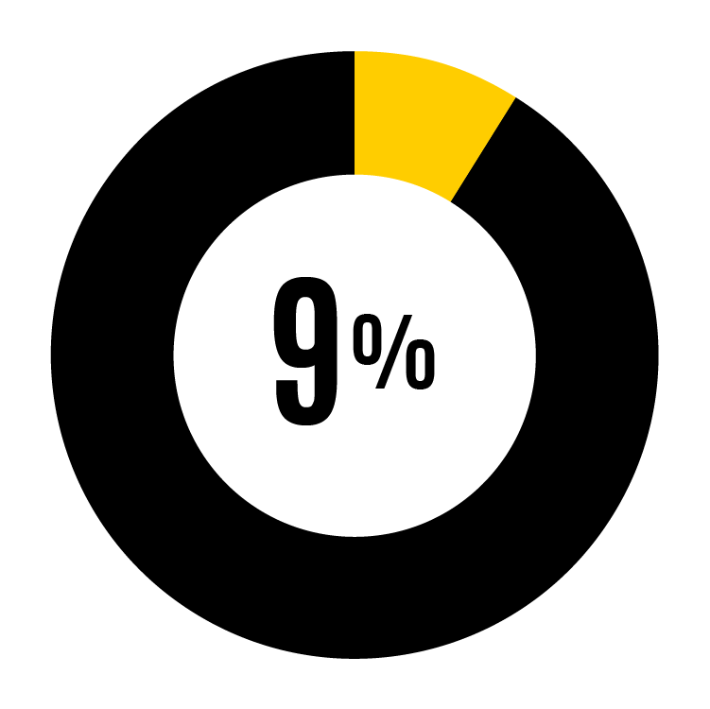
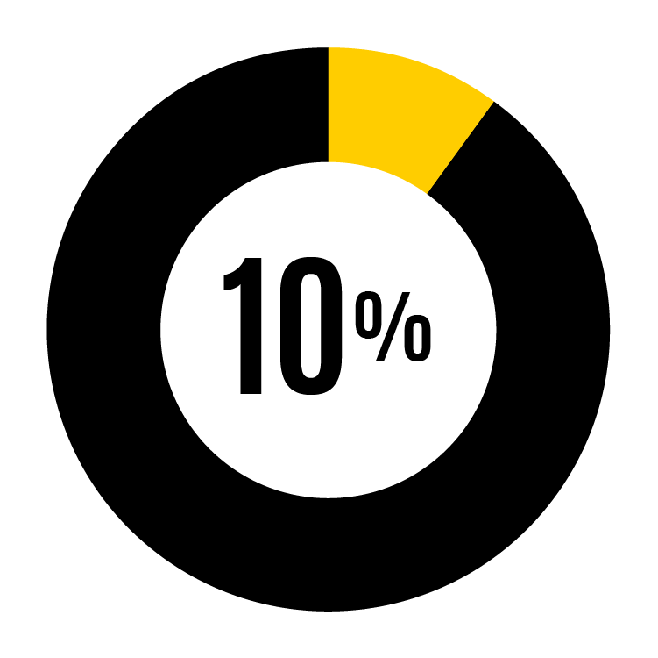
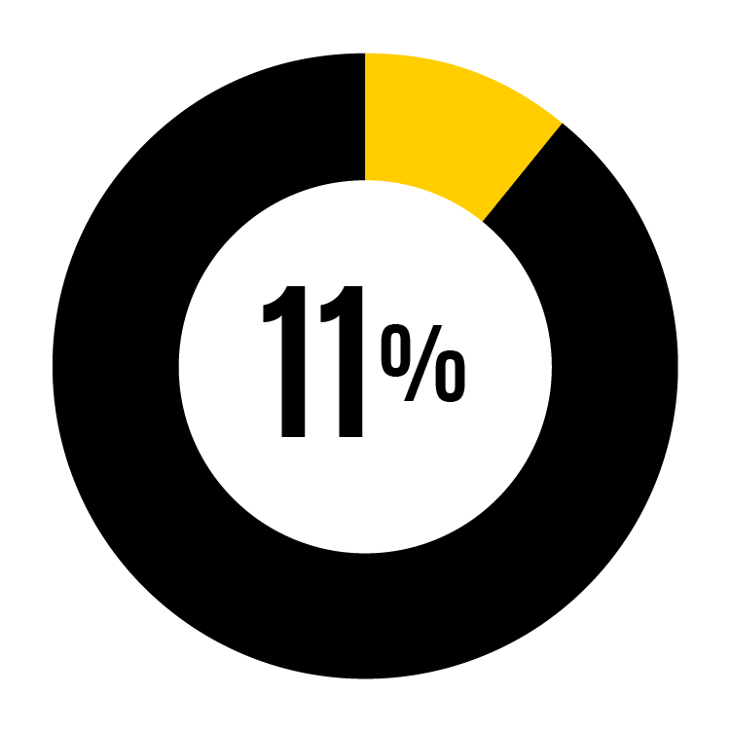
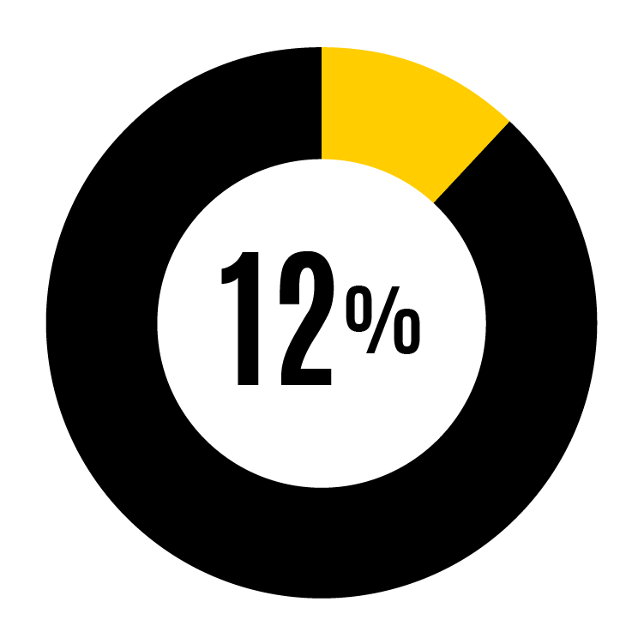
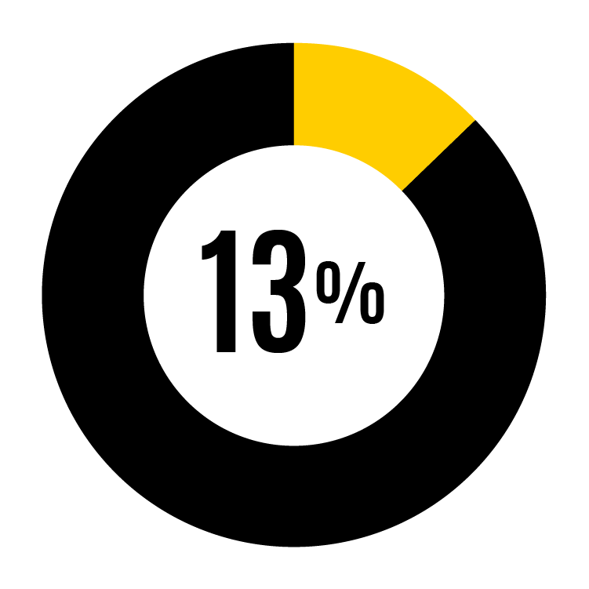
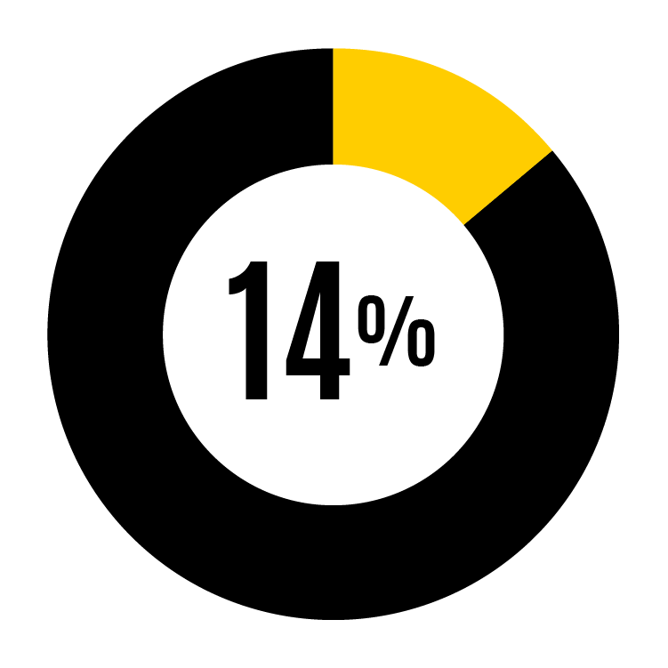
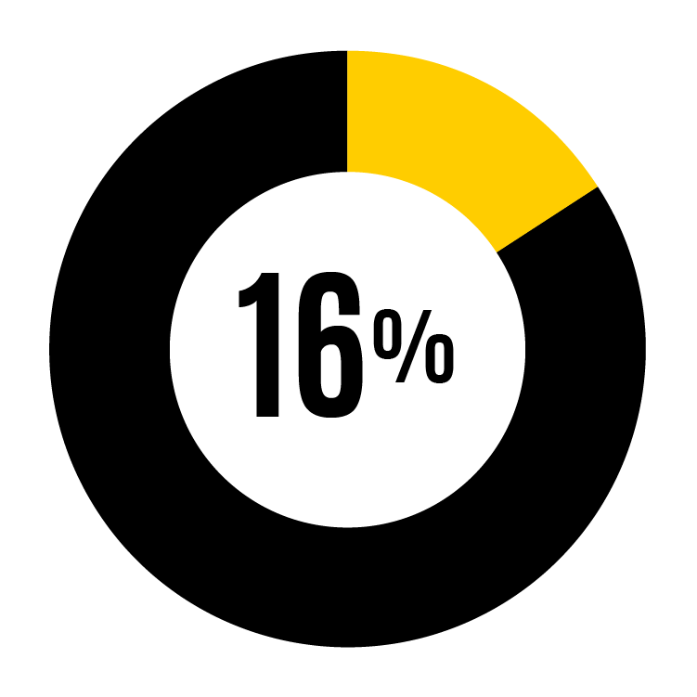
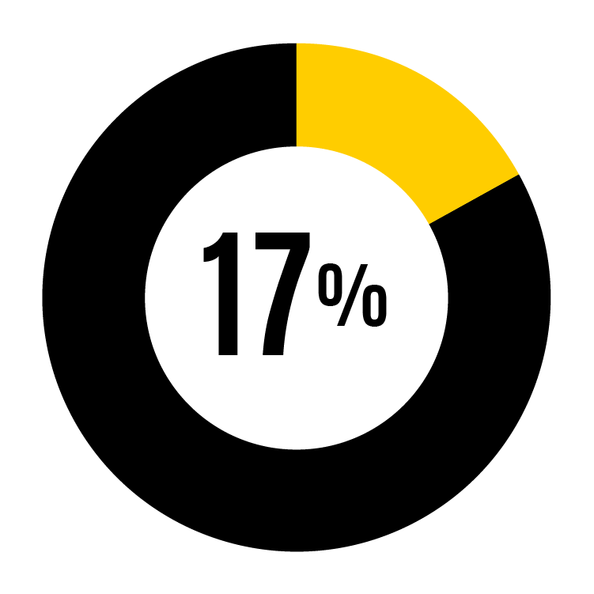
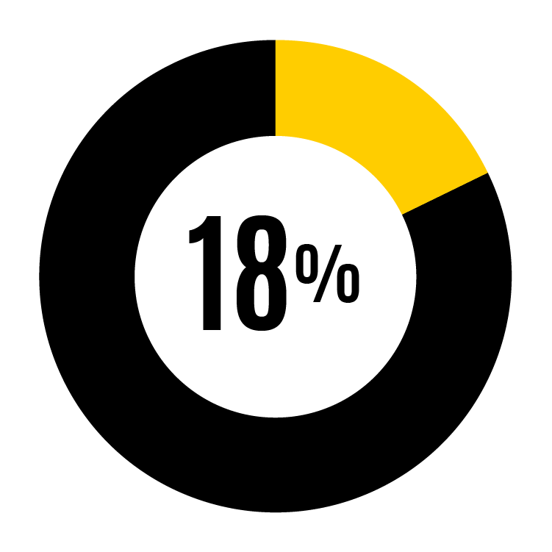
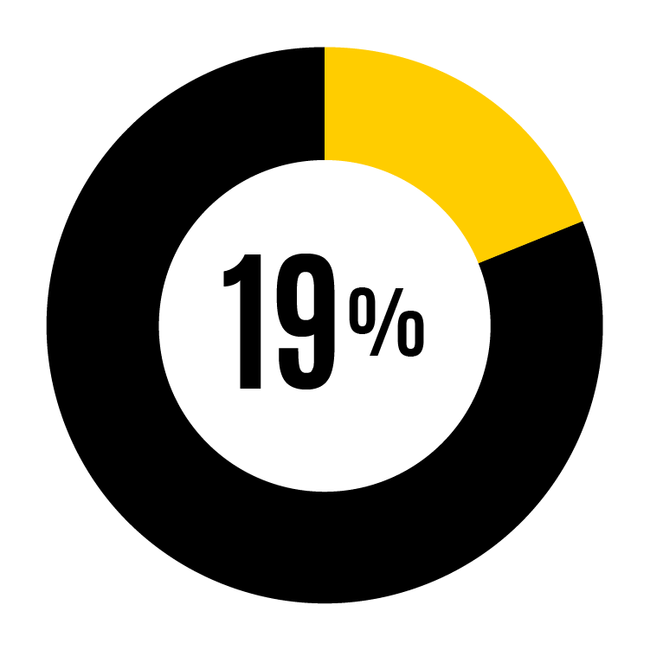
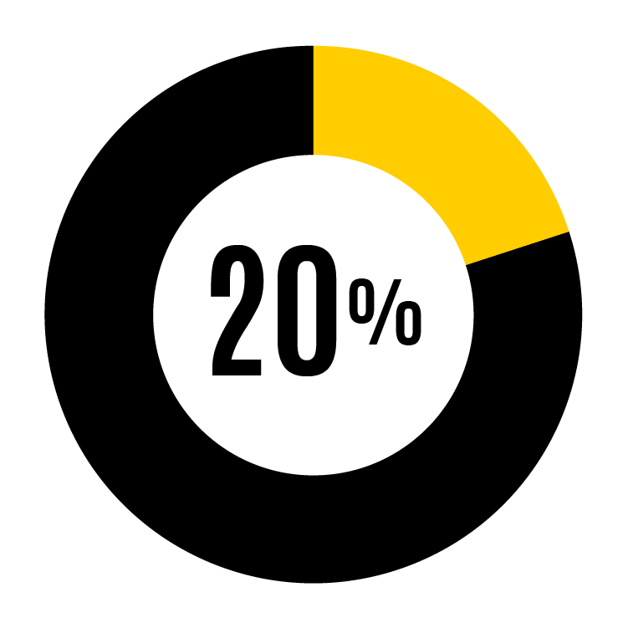
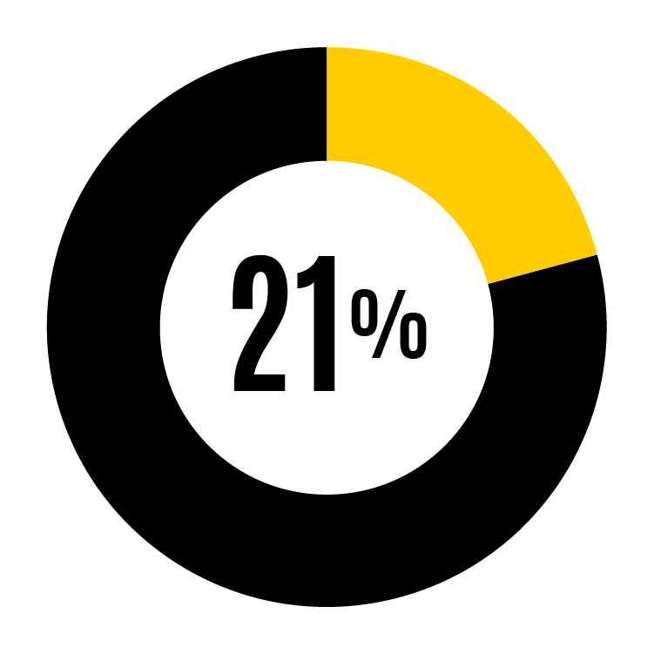
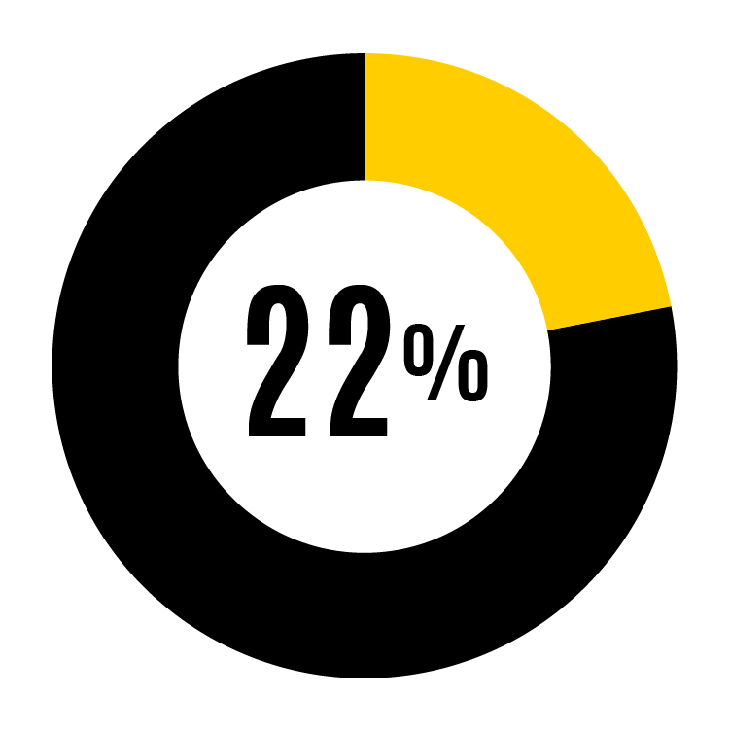
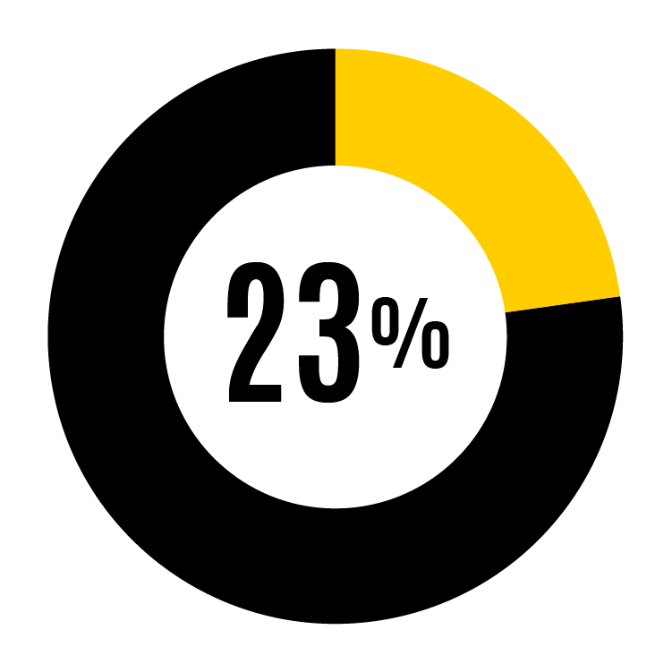
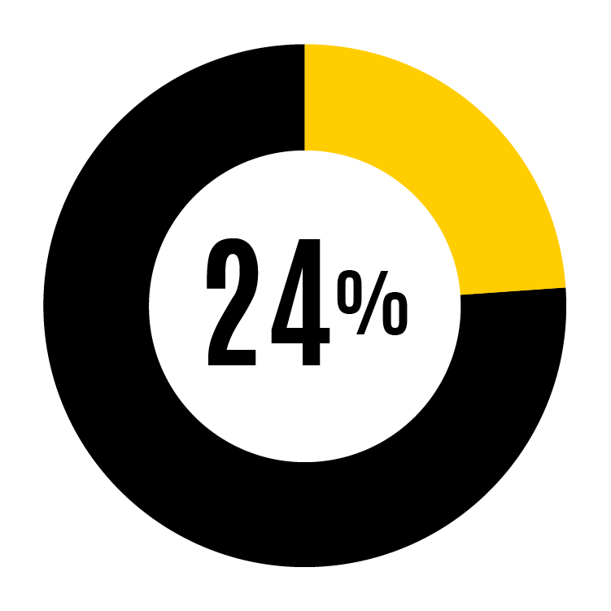
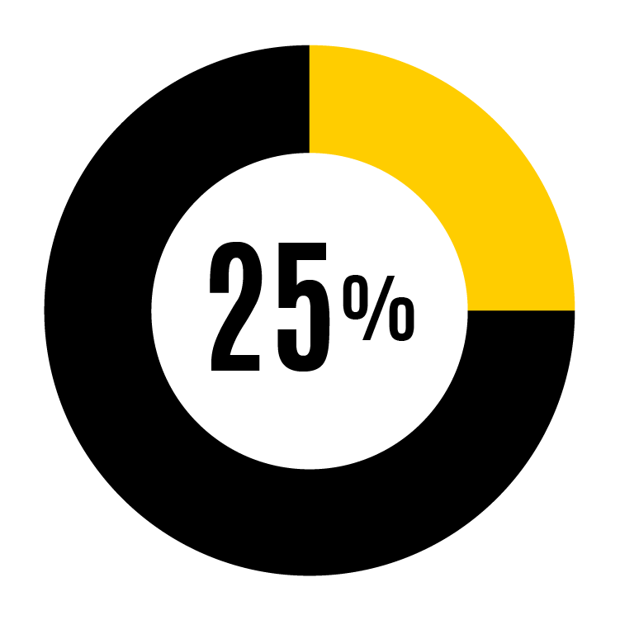
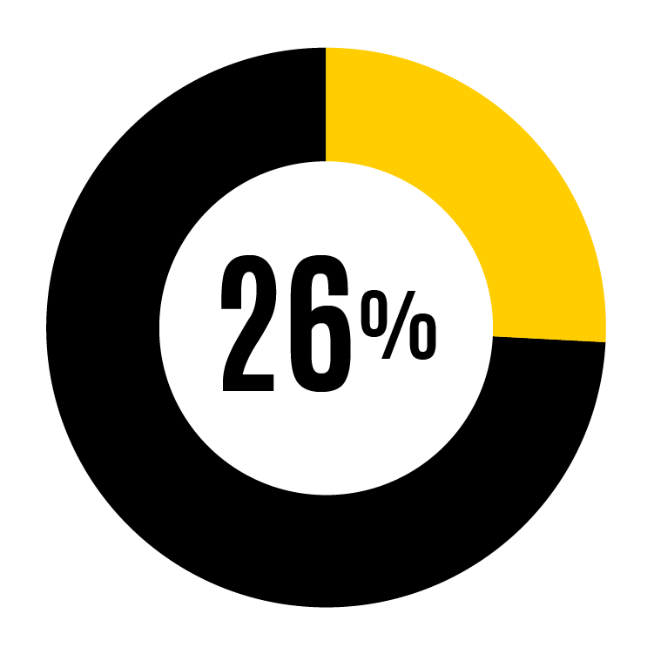
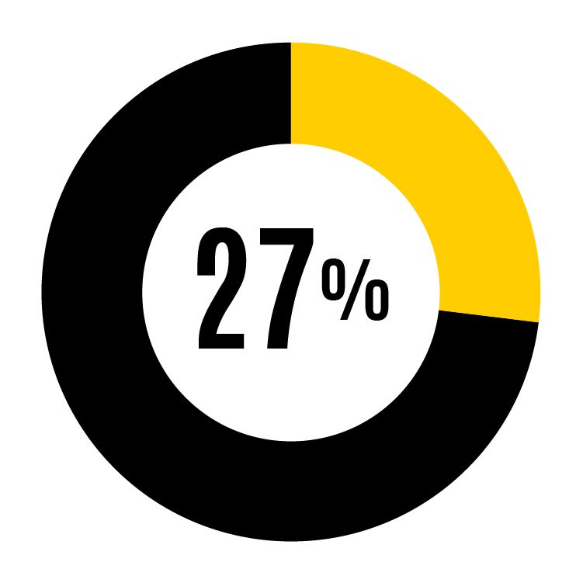
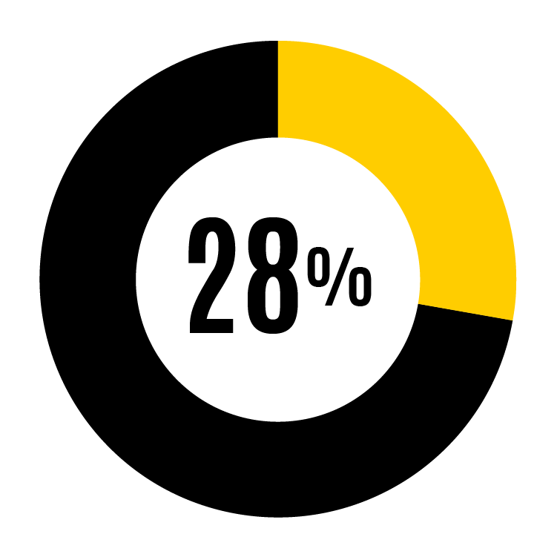
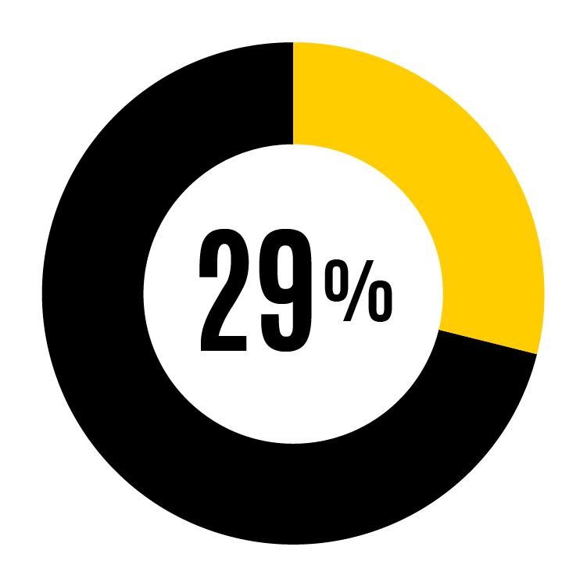
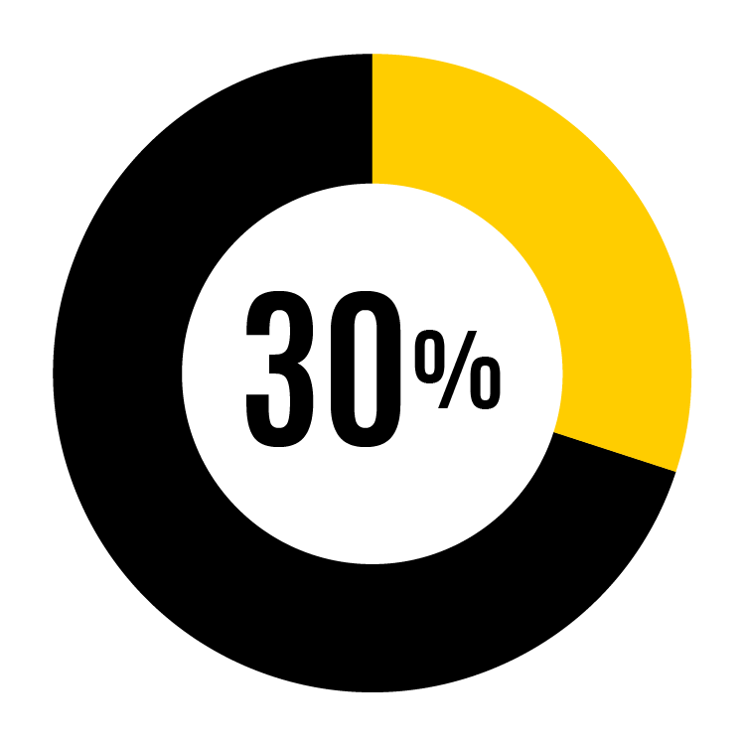
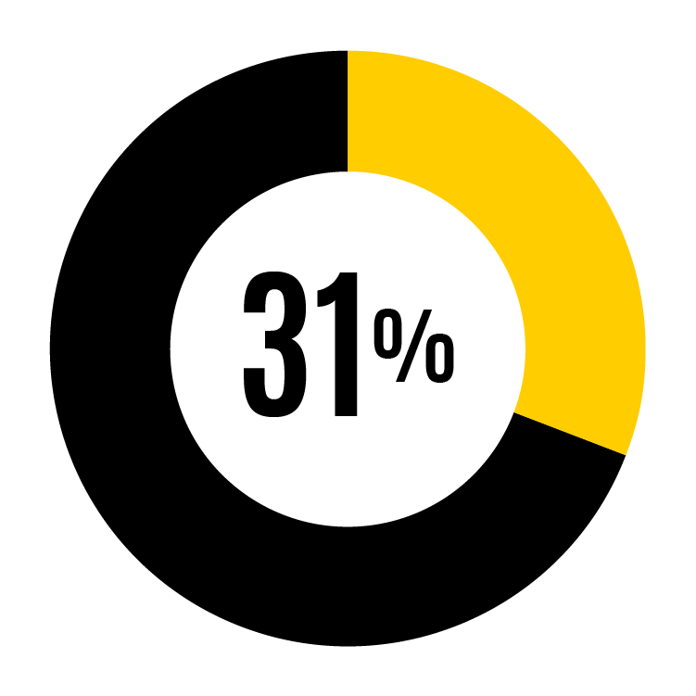
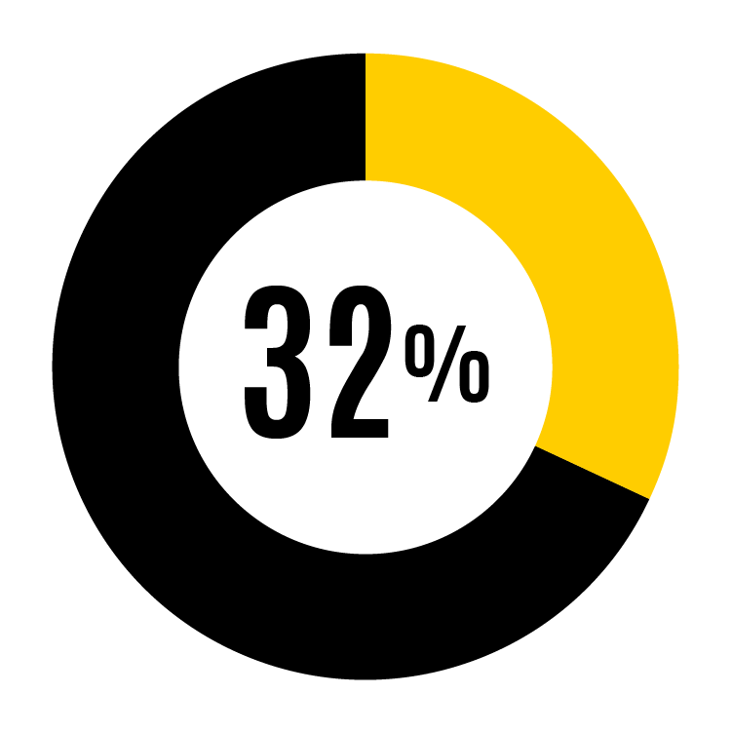
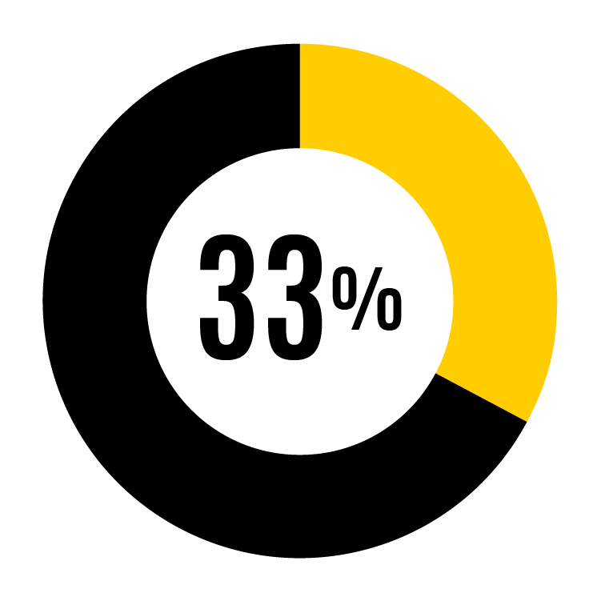
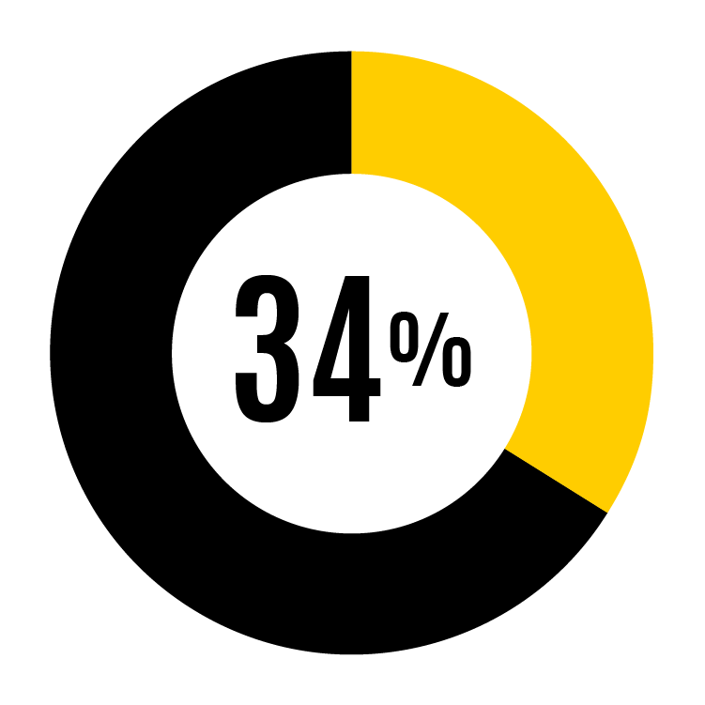
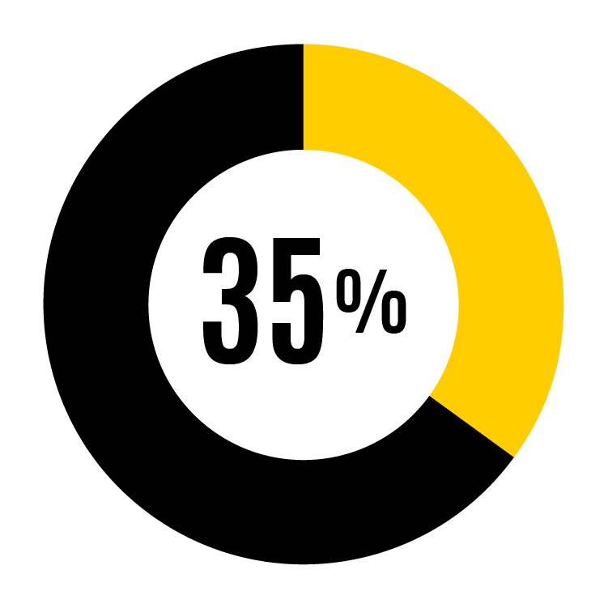
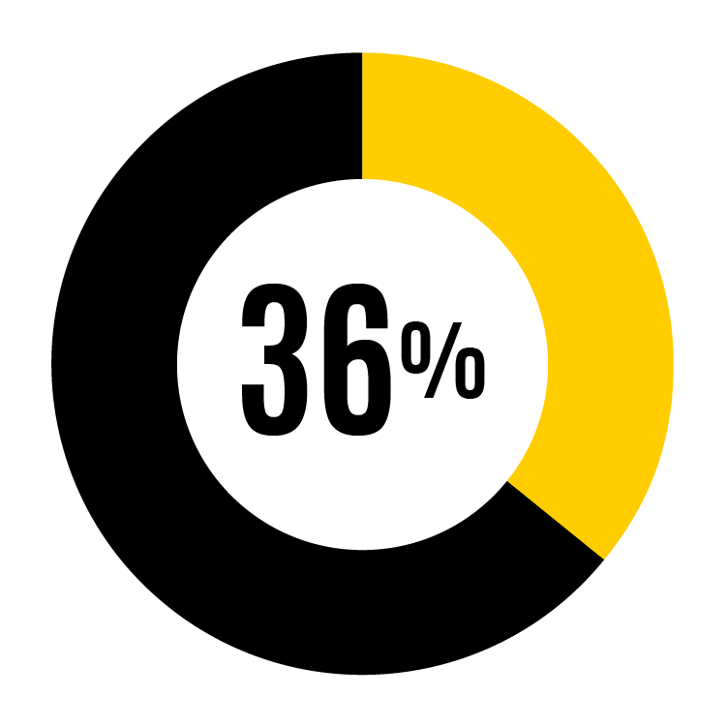
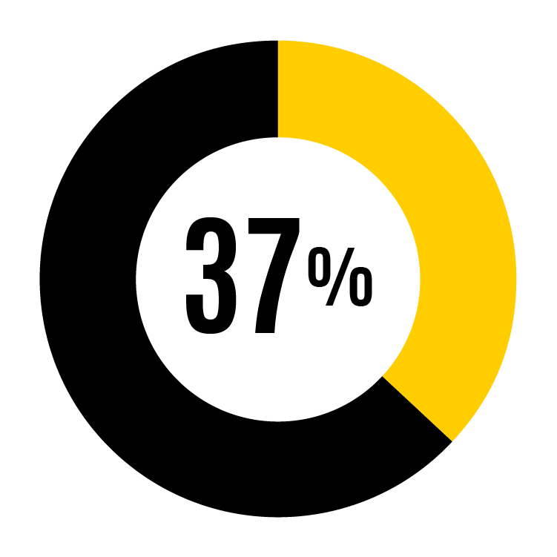
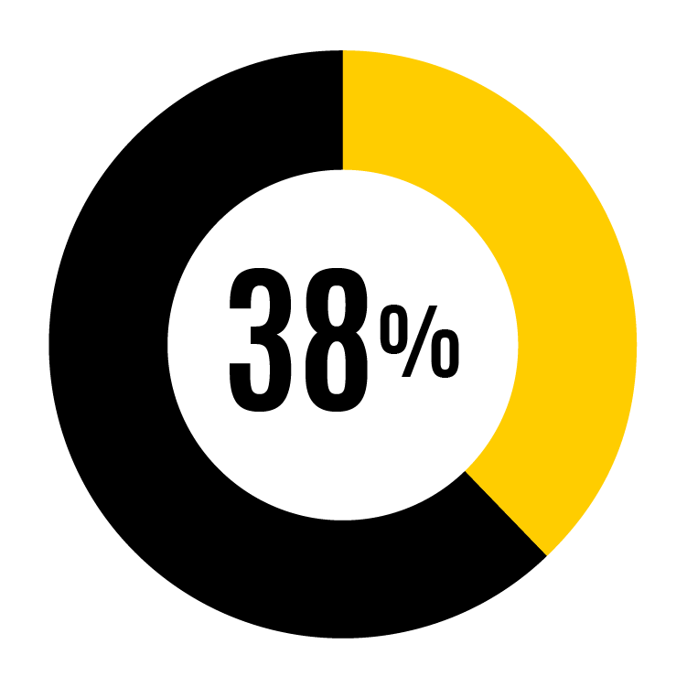
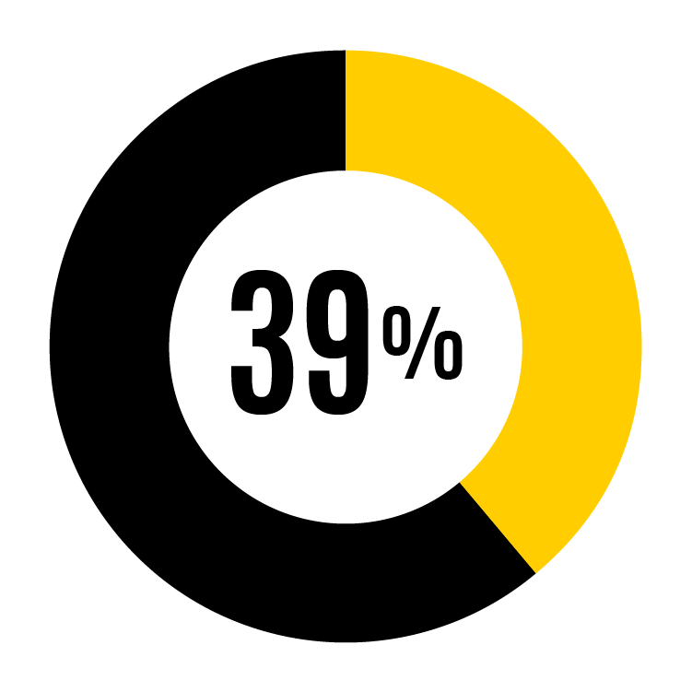
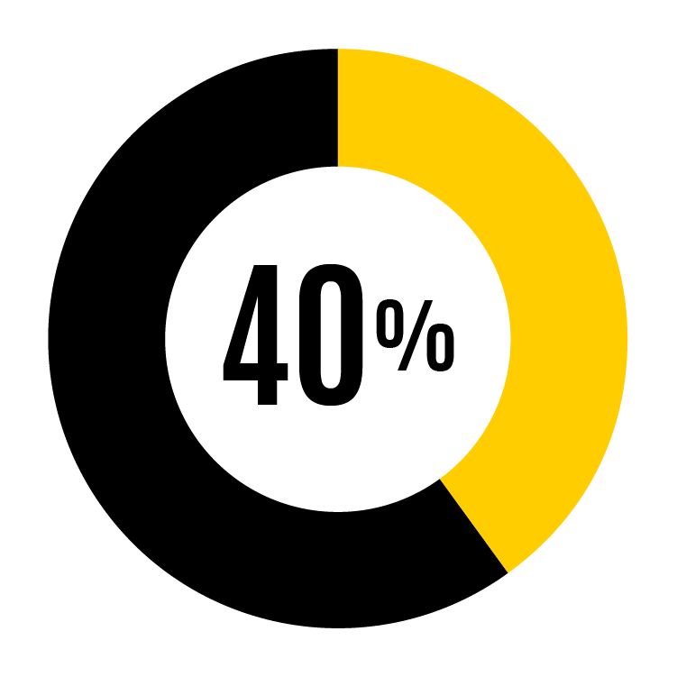
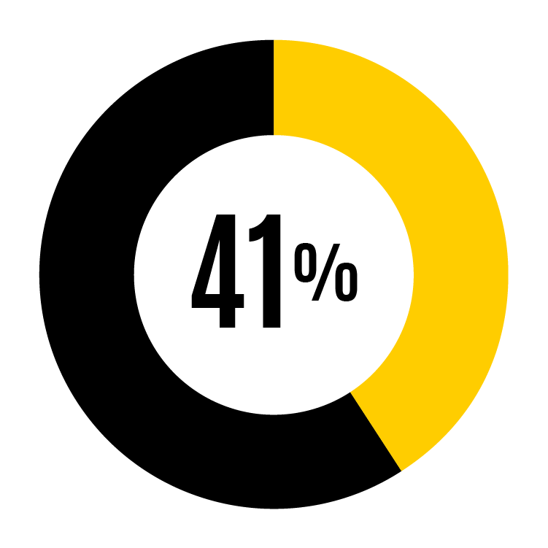
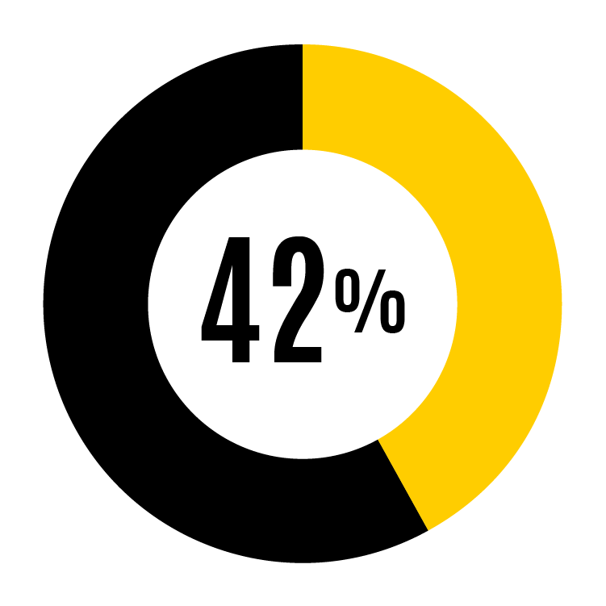
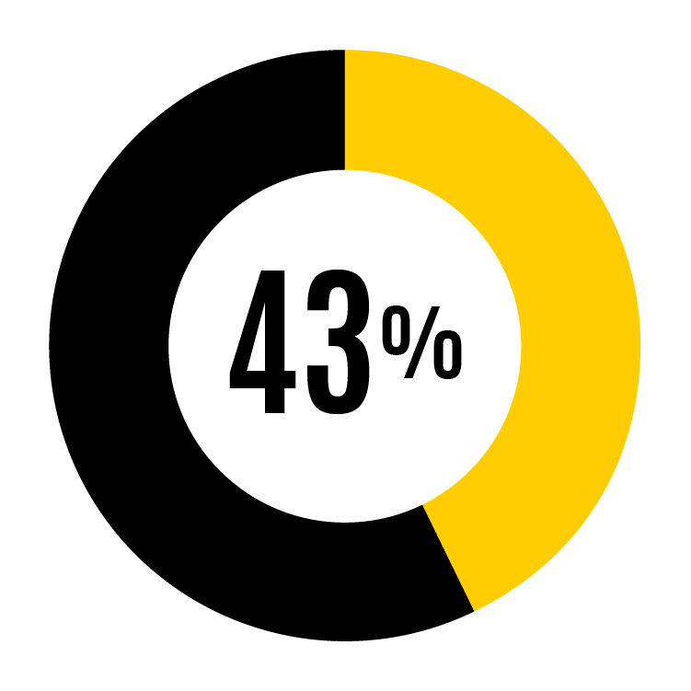
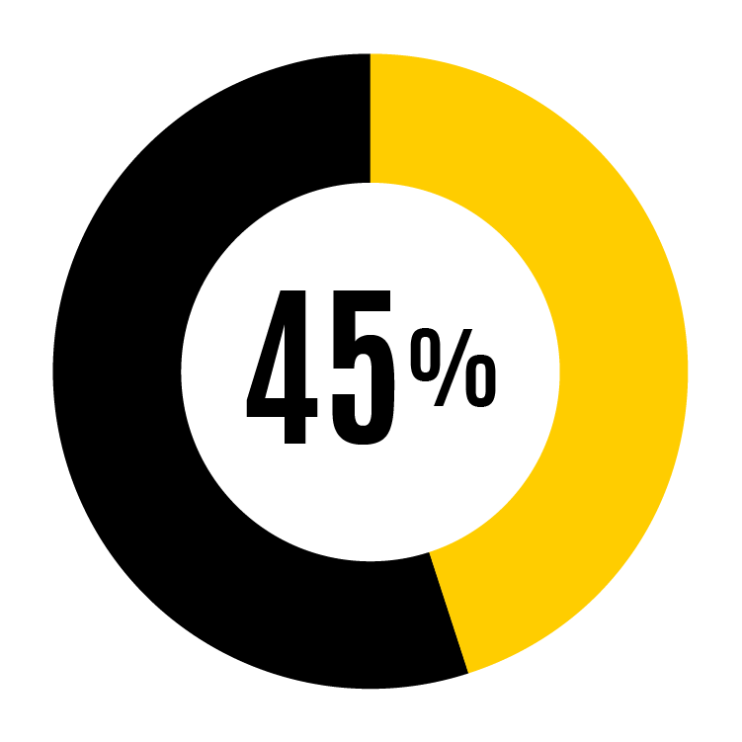
Standard Percentages

Slide 19
Standard Percentages (cont.)

Slide 20
Engagement: 3 types of behaviors
Physical
Mental
Emotional
I work with high energy
I exert my full effort
I devote a lot of my energy
I give my full attention to my job
I concentrate completely
My mind is focused on the work that I do
I put my emotions into what I do
I am emotionally connected
I put my feelings into my work
Notes:
Since 2018, WAI report includes an engagement index.
Validated scale provided by Dr. Eean Crawford, faculty member in the Tippie College of Business.
Engagement behaviors show how personally connected people are to their jobs in terms of giving their full effort, paying close attention to their work, and emotionally caring about what they do.
When faculty and staff are engaged, they are more likely to be productive, effective, and happy, and to create a positive work culture for themselves and others.

Slide 21
Engagement score result

Slide 22
Sample - org strengths/opportunities compared to UI
Strengths
Opportunities
% respondents that agree (strongly agree, agree, or slightly agree)

Slide 23
Action Planning

Slide 24
Next steps & action planning
Action planning resources:
Using Working at Iowa results

